Slide 1
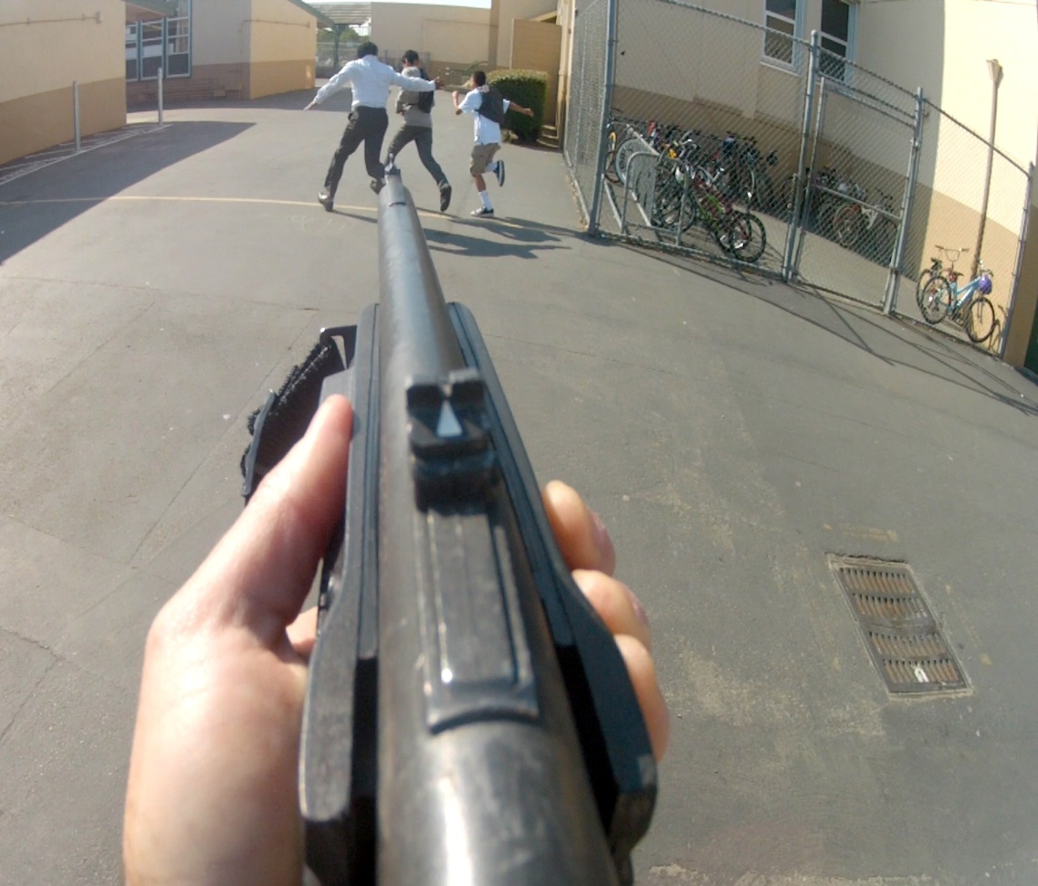
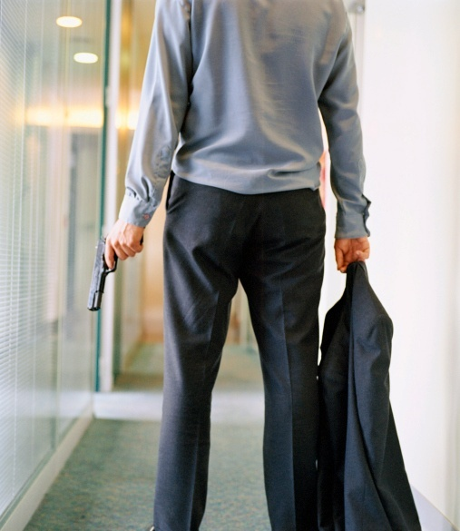
Active Shooter Response Training
Santa Clara County
Police Chief’s Association
Notes:
This version is oriented towards schools.

Slide 2
TRAINING OBJECTIVES
Offer strategies to prevent and prepare for a potential Active Shooter incident
Provide options to enhance survival when confronted with an Active Shooter
Describe actions needed to safely interact with the responding police officers

Slide 3
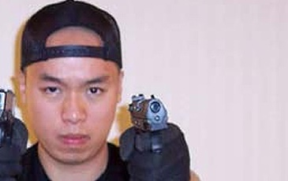
Definition of an Active Shooter
An Active Shooter is a subject or subjects actively engaged in killing or attempting to kill people in a confined and populated area; Active Shooters primarily use firearms and there is no pattern or method to their selection of victims
Notes:
The term “Violent Intruder” may provide a more comprehensive alternative to “Active Shooter”.

Slide 4
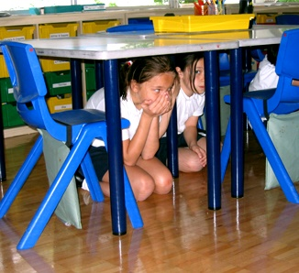
Active Shooter Events
Unpredictable
Evolve quickly
Continue until stopped by law enforcement, suicide or other intervention

Slide 5
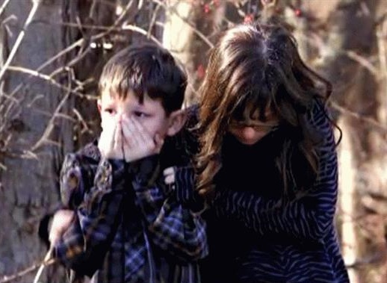
The Tragic Reality
Columbine High School
Virginia Tech University
Oikos University
Sandy Hook Elementary School

Slide 6
It happens frequently (and continues to happen…)
Columbine High School, Colorado
Pennsylvania Amish School
Virginia Tech University
Fort Hood, Texas
Lehigh Cement Plant, Cupertino, CA
Oikos University, Oakland, CA
Aurora, Colorado
Newtown, Connecticut
Santa Monica Community College, CA

Slide 7
Lessons Learned:
Taking action makes a difference
NEUTRALIZING THE THREAT IS NECESSARY TO SAVE LIVES
Active Shooter Events are often over within 10-15 minutes (before the police arrive in half the cases)
Response to minimize or eliminate the threat will need to be taken by YOU

Slide 8
Prevention & Detection of Active Shooter Events
Harden the target (security upgrades)
Video surveillance of open areas
Peep holes on doors
Report suspicious activity to police and your administration
Implement an anonymous reporting system
Consider a multi-disciplinary team to assess potential threats
Train and prepare!
A survivor mindset is critical

Slide 9
Red Flag Indicators
Although no single set of warning signs are reliable predictors of an Active Shooter, there can be “red flags”.
A “red flag” indicator is a questionable, suspicious or inappropriate behavior that may be presented through someone’s appearance, spoken or written words, or specific actions.

Slide 10
Examples of Red Flag indicators:
Behaviors which regularly interfere with classroom environment
Overly aggressive behavior or threats toward others
Poor decision-making and coping skills
Low frustration tolerance; overreaction to circumstances; anger management problems
Notable change in behavior or appearance
Writings, comments or social network postings endorsing violence; an unusual interest in violence

Slide 11
Run, Hide, Defend: Options for surviving an Active Shooter Event
Whether in Newton, Connecticut or tornado-ravaged Oklahoma, teachers and school staff have become the first (and last) line of defense for our children
Notes:
Use of the term “DEFEND” can be addressed in slide #22

Slide 12
RUN = Evacuate
Decide if you can escape safely
If it is safe, run as fast as you can away from the direction of the gunshots
DO NOT stop running until you are far away from the area
Leave your belongings behind
Help others escape, if possible
Prevent individuals from entering the area, but not at the risk of your own safety

Slide 13
RUN (other considerations)
Get away from the threat and identify a safe place
When fleeing from danger, keep buildings, cars or other objects between you and the threat
Do not attempt to move wounded people
Call 911 when safe

Slide 14
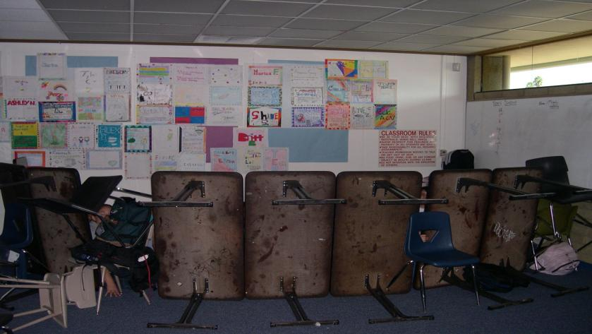
HIDE = Lockdown
If escape is not feasible; hide and create a stronghold
Lock the door, turn off the lights and close the blinds
Take cover behind large items
Silence your cell phones and turn off vibrate mode
Remain quiet
Move away from doors and windows

Slide 15
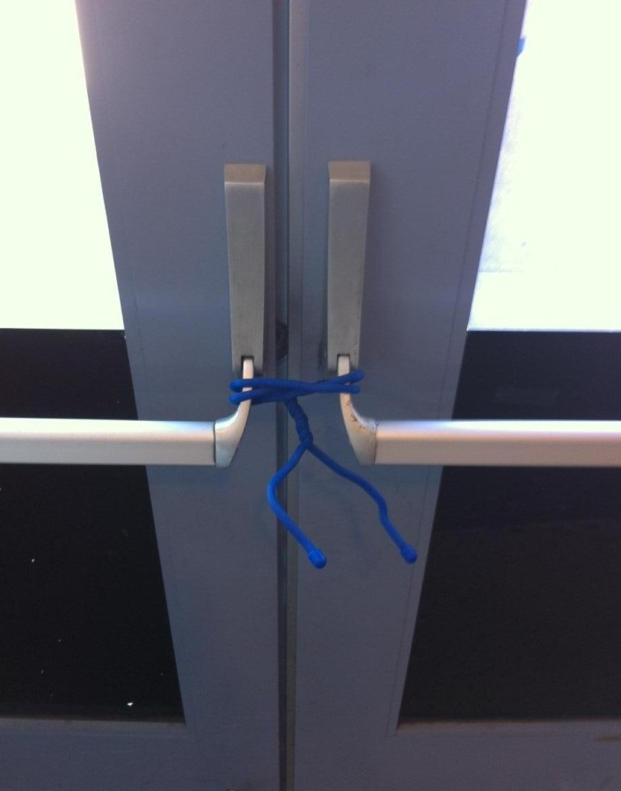
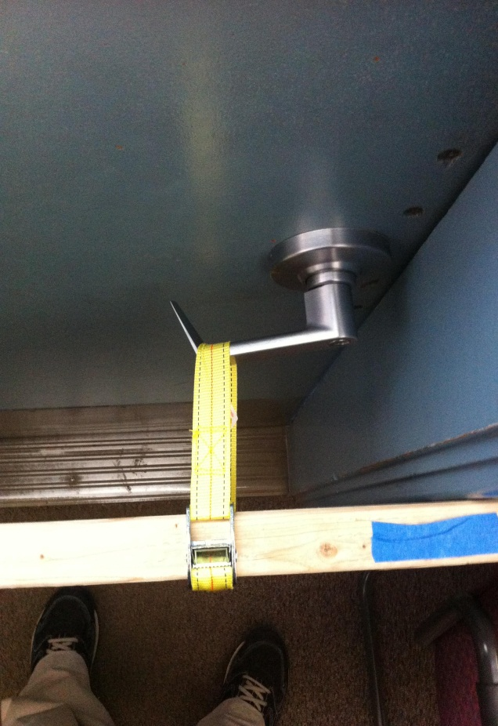
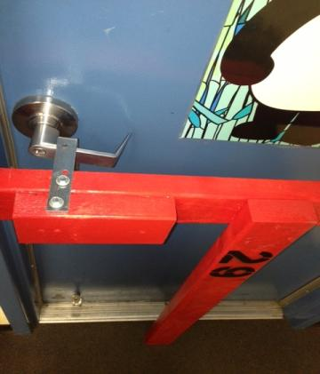
Reinforce the locked doors with chairs, desks, and other items

Slide 16
Erect barricades on ALL of the doors
Fill in the voids
Suspect will take the Path of Least Resistance

Slide 17
Good example of a barricade
Reinforce the primary barricade

Slide 18
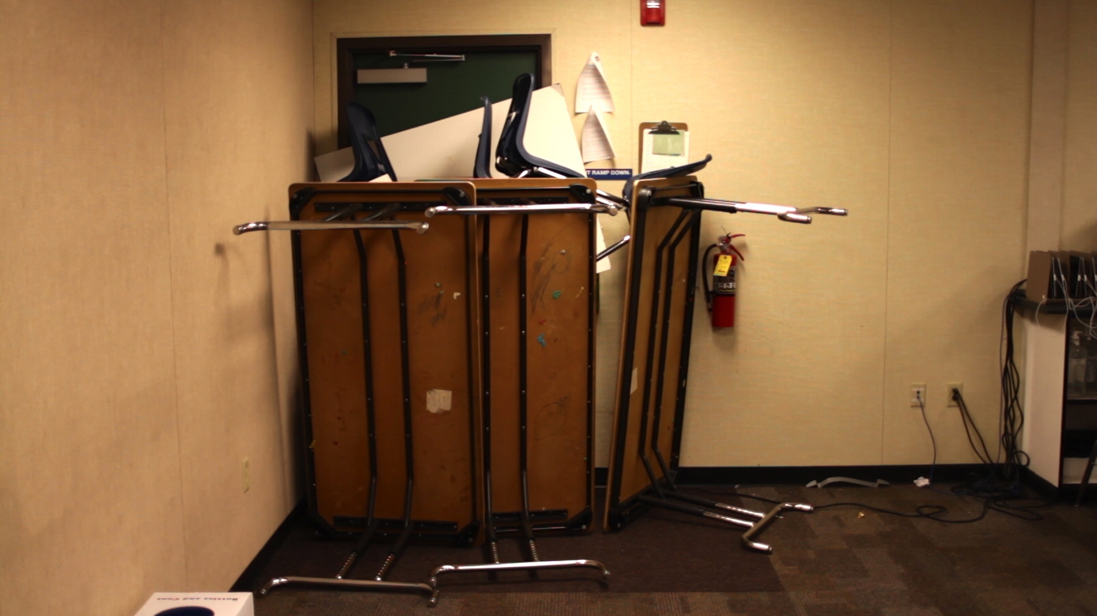

Slide 19
HIDE (other considerations)
Call 911 when it is safe to do so
Once you have secured the door do not open it for anyone. Police will enter the room when the situation is over.
Prepare yourself mentally and physically for the possibility of engaging the shooter
Put yourself in a position to surprise the suspect(s) if they enter the room.

Slide 20
DEFEND = Fight for your Life
This is a last resort
Commit to your actions!
Act as aggressively as possible
Improvise weapons
Attack in a group (Junior High & above)
Yell and and make loud noises to disorient the shooter
If possible, grab the shooter’s limbs and head, take them to the ground and hold them there.
Notes:
Clarify the term “DEFEND” as opposed to “FIGHT”. Data shows that taking some kind of action to defend your life or the lives of your students significantly increases the chance of survival.

Slide 21
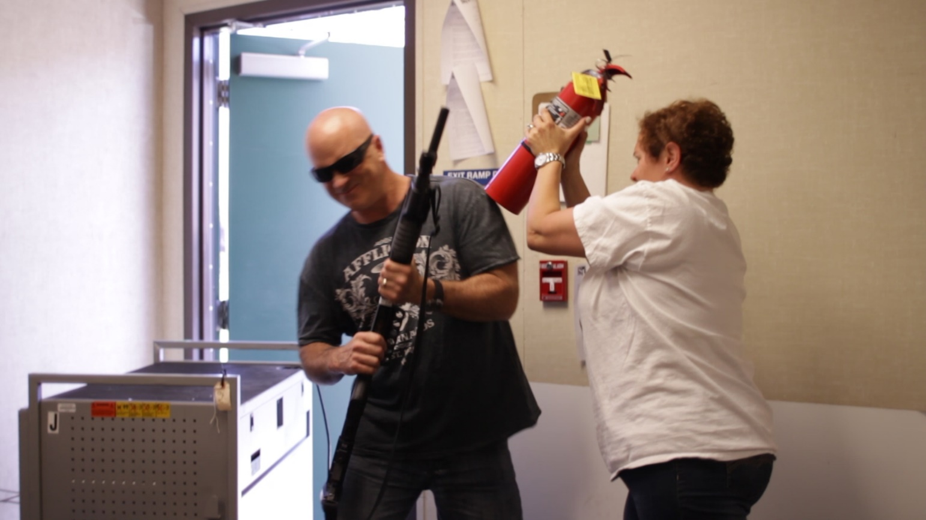

Slide 22
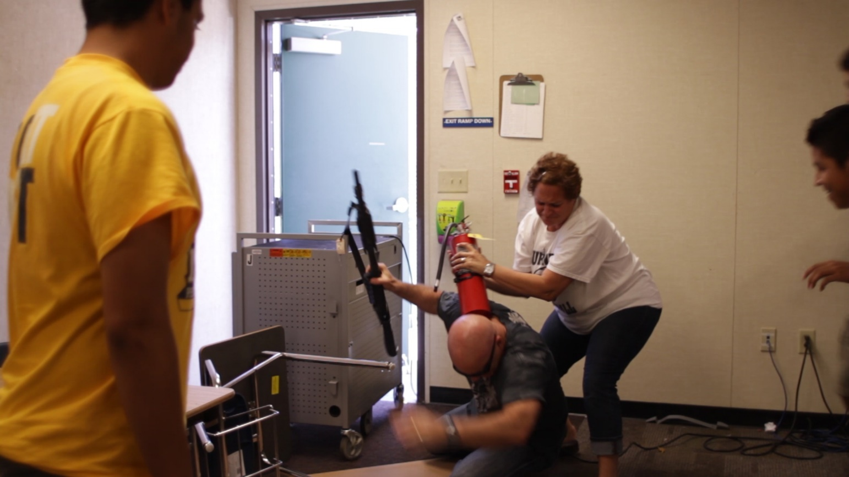

Slide 23
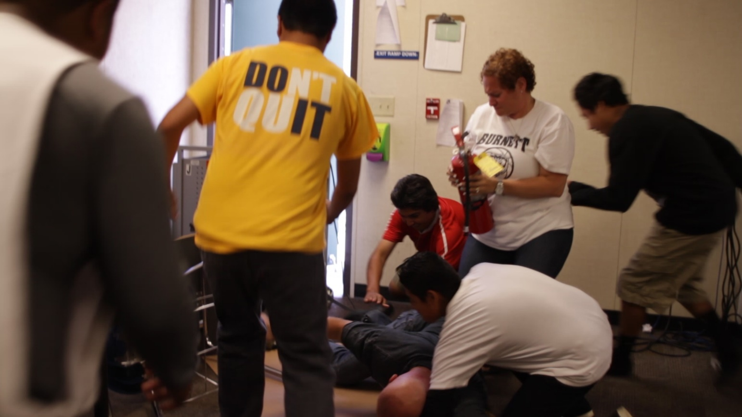

Slide 24
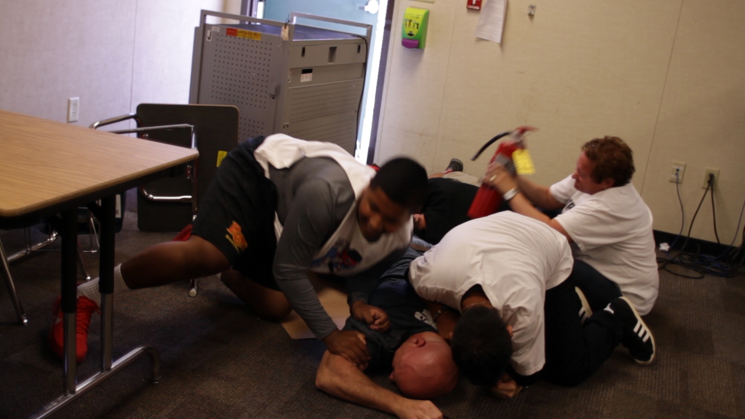

Slide 25
When police officers arrive on scene
Their first priority is to eliminate the threat
Officers will advance to the area where the last shots were heard
Initial officers will not tend to injured victims nor stop to speak with you

Slide 26
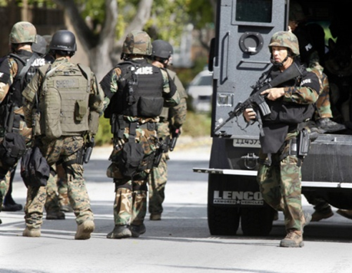
Additional Officers and Rescue Teams
Officers may not be wearing traditional police uniforms
Instead they may be in “tactical” gear with rifles, helmets and ballistic vests
To minimize risk, everyone must be treated as a suspect until the suspect is identified
Officers will issue loud commands and may get physical

Slide 27
Reacting to Law Enforcement
Remain calm
DO NOT approach officers
Follow all instructions by officers
Put down any items and DO NOT pick up any weapons
Raise hands and spread fingers
Avoid quick movements
Avoiding pointing, screaming or yelling at officers
If you are barricaded in a room, DO NOT open door

Slide 28
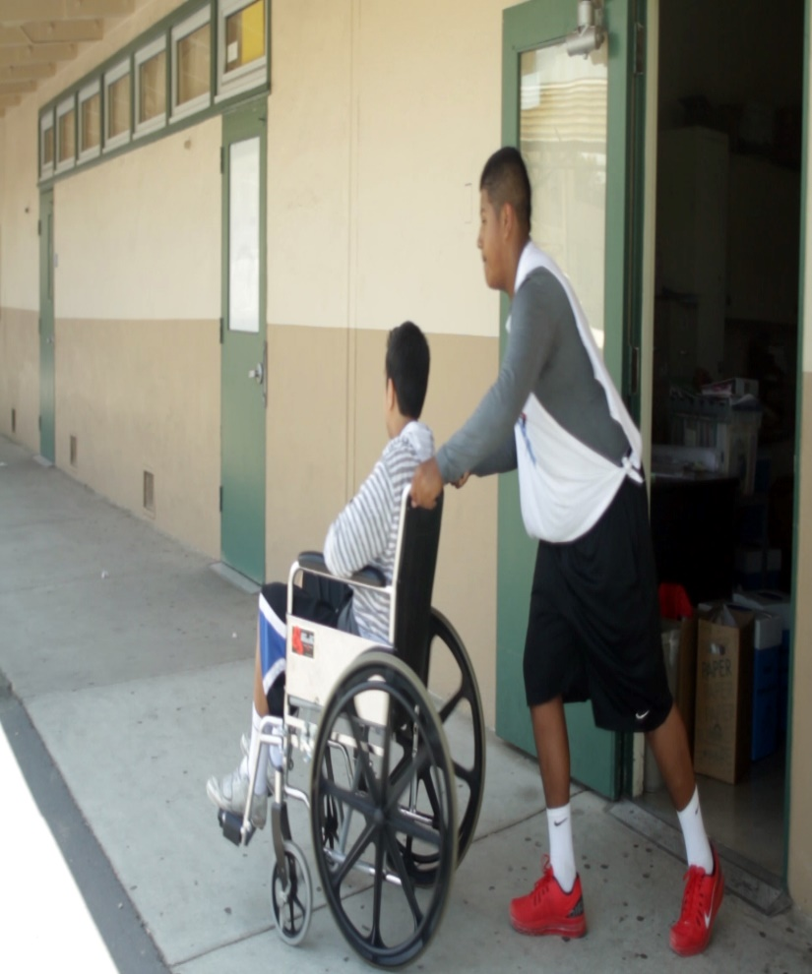
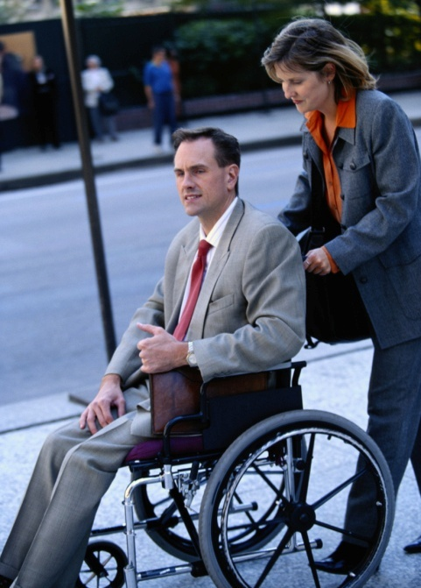
Other Considerations
Be aware there may be situations where people:
May have limited or no English proficiency
May be hearing or sight impaired
May be mobility impaired
Do the best you can to help without putting yourself at risk

Slide 29
Shelter in Place
Situations where there is no immediate threat to the school
Dangerous incident in the surrounding neighborhood
Dangerous incident at a nearby school
Any situation where you feel keeping students inside is the safest alternative
Notes:
Also referred to as “Code Blue”

Slide 30
Shelter in Place Considerations
Lock all doors, close windows (no barricades)
Remain inside; engage in normal indoor activities
Keep movement outdoors to a minimum
Use buddy system with at least one adult when leaving classroom
Before leaving classroom, notify office or next door classroom
If students are to be released; it should be by direct hand off at a location determined by the school administration
School administrators may give the “All Clear” announcement
No special code

Slide 31
Activity: What Would You Do?
Instructions
Working as a team:
Look around the room. Consider what you would do in an active shooter situation and whether it would be better to Run (escape) or Hide (barricade)
Come up with a list of actions you would take to protect yourself and those around you
Select a spokesperson and be prepared to report back to the class in 5 minutes

Slide 32
Training Summary:
Plan & prepare ahead of time
Be aware of your environment
Always know your escape route
Your survival options in an Active Shooter Event: RUN, HIDE, DEFEND!
Call 911 when it is safe to do so
Never approach an officer during an active shooter situation

Slide 33
Questions or comments?
Sgt. Jason Pierce #3380
Ofc. Manny Vasquez #2629
Ofc. Ben Gonzalez #2704
Ofc. Catherine Velasquez #3465
San Jose Police Department
School Liaison Unit
408-277-5263

